Slide 1
Project Applications Review
Purpose: Review FY2026-2032 Phase II Applications
Toni Tisdale, Principal Planner,
Transportation Resource Development Team Lead
Sherone Sader, Resource Development Assistant
Notes:
Use this exact title slide (exact wording) for RTAC and Board.
For other presentations, DO still use the standard COMPASS slides (the gray with the logo), but you do not have to use this wording on your title.

Slide 2
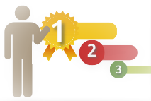
What we’ll cover today:
Review of ranking process
Understanding of preliminary scoring process
Specific details for each federal application
Provide discussion among all organizations
Next Steps.

Slide 4
Application Process
1st Call for Project Applications –
September 16, 2024
Phase I Applications Due – November 20, 2024
Phase I Reviews Due – December 20, 2024
Phase II Federal Applications Due
Due January 21, 2025
2nd Call for Phase I Applications Due May 1, 2025
Paired Comparison Ranking for Federal Studies Projects February 5-12, 2025
Phase I Final Review Workshop June 4, 2025
FEDERAL $
LOCAL $
RTAC Recommends Ranking for Federal Programs
February 26, 2025
Paired Comparison Ranking for CIMI and PDP Projects June 5-19, 2025
RTAC Recommends the Federal Funding Plan
March 26, 2025
RTAC Reviews/Recommends CIMI and PDP Projects
July 23, 2025

Slide 5
Roadmap to Ranking:
Paired Comparison
Ranking
Unscored Projects
Studies, COMPASS local programs
Scores
TIP score, including 20% of CIM
Scoring
Informative
Preliminary rank
Ranking
Scored Projects
STBG, TAP, CRP
Notes:
Looking at that ranking process in broad strokes,
I first want to highlight the distinction between scored and unscored projects
Unscored projects include applications for local funds (that is applications for the Project Development Program and CIM Implementation grants) as well as application for studies.
These unscored projects are prioritized using the paired comparison process – identical to previous years
Now, turning to the scored projects,
These are project applications for capital and maintenance improvements seeking federal-aid funds (STBG, Tap and CRP funds).
These projects are first assigned a ‘tier’ based on their alignment with CIM 2050.
Projects that align with all or part of a priority identified in CIM will be placed in tier 1 and prioritized throughout the process. All other projects are placed in tier 2.
Regardless of tier, all projects will also be scored according to their contribution to the regional vision, goals, and objectives.
The projects will then be placed in order with Tier 1 over Tier 2, and then scores from highest to lowest, forming the first draft of the project application ranking. The scores will then be an informative tool to help structure further discussion and decision making
Now, lets focus in on the scoring criteria for a moment.

Slide 6
Purpose of Scoring
Supports CIM 2050
Describe project impact
Outcomes
Integrates Products
Objective evaluation
Facilitate conversations
Notes:
The criteria used to evaluate project applications were developed with the assistance of an RTAC subcommittee (including representation from ACHD, VRT, and the cities of Nampa, Boise and Eagle).
The Criteria knit together a number of COMPASS planning products and are structured around the Regional vision and goals described in CIM
These criteria provide an objective and replicable evaluation of project impact that can help to foster conversations and facilitate comparisons between projects
Safety was emphasized in the in the scoring criteria (and received the most points), but COMPASS priorities and goal areas are represented. Additionally, local preference and project readiness are captured within the bonus section.

Slide 7
CIM 2050 Goals Areas
CIM
Max 26 pts.
Safety
Economic Vitality
Max 40 pts.
Quality of Life
Max 25 pts.
Convenience
Max 15 pts.
Bonus
Max 25 pts.
Max 25 pts.
Notes:
The criteria used to evaluate project applications were developed with the assistance of an RTAC subcommittee (including representation from ACHD, VRT, and the cities of Nampa, Boise and Eagle).
The Criteria knit together a number of COMPASS planning products and are structured around the Regional vision and goals described in CIM
These criteria provide an objective and replicable evaluation of project impact that can help to foster conversations and facilitate comparisons between projects
Safety was emphasized in the in the scoring criteria (and received the most points), but COMPASS priorities and goal areas are represented. Additionally, local preference and project readiness are captured within the bonus section.

Slide 8
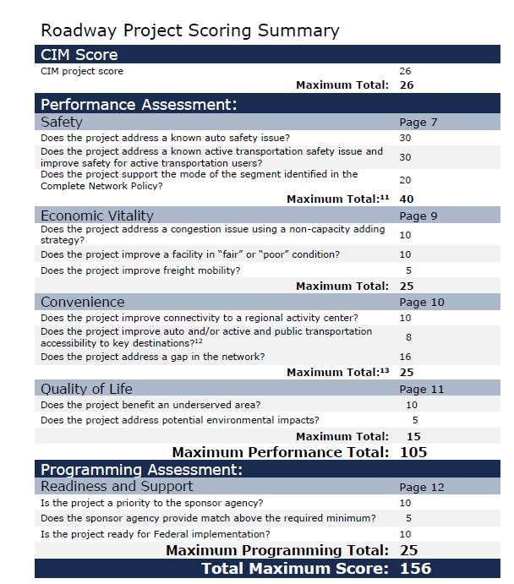
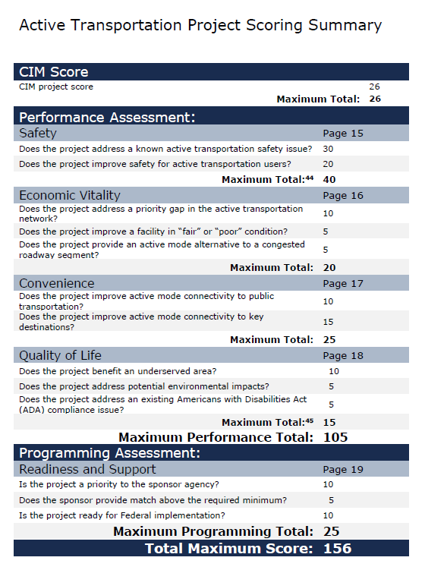
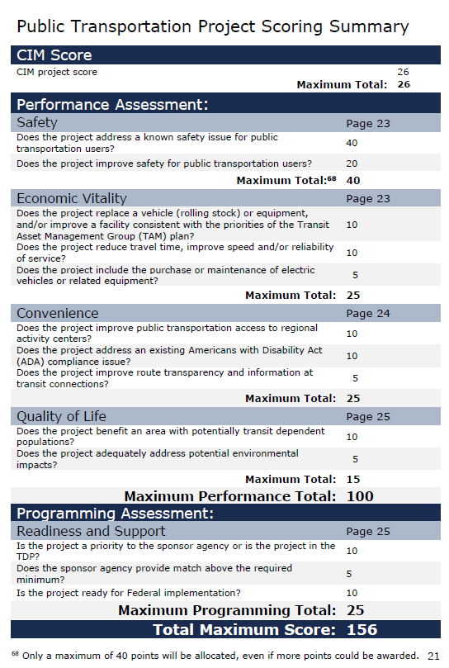
Scoring Criteria
5/15
Notes:
This scoring process is fleshed out by detailed criteria and thresholds customized for each primary mode and tested on dozens of sample projects.
~~~~
The scoring process is underpinned by detailed criteria and thresholds,
- Particular criteria were developed for each mode – including auto (as well as [spell out] TSMO/ITS), Active transportation, and public transportation.
- These criteria knit together a number of COMPASS planning products, including
CIM 2050 priorities
Regional crash safety data - Congestion Management Process (analysis and Toolkit)
I-84 operations plan (namecheck hunter) - Treasure Valley TSMO Plan
Pavement, bridge, and facility condition (PMF data)
Complete Network Policy (freight network, regional activity centers)
Equity analysis - Environmental index - Bike-Walk COMPASS (AT network)
Pathway facility condition (Data-bike)
So, all of these planning tools contribute to the evaluation of project applications
Tested by evaluating dozens of projects over the past 5 years
Integrated into project evaluation and inform decision making
[ask RTAC SC to add anything if they want]

Slide 9
Summary Ranking - Studies
Prelim Rank* | Project | Sponsor
 | High Injury Network | COMPASS
 | Fiscal Impact Analysis | COMPASS
 | Pavement Condition Analysis | COMPASS
 | Complete Network Policy | COMPASS
*currently shown in order of applicant priority

Slide 10
Summary Ranking - Alternative
Prelim Rank | Project | Sponsor | Score
1 | Ridenbaugh Canal Pathway | Boise | 136
2 | Pedestrian Crossing at 32nd Street, Garden City | ACHD | 108
3 | Interstate 84B, 39th to Sugar Road, Sidepath | Nampa | 93
4 | 11th Avenue Sidepath | Nampa | 87
Notes:
We will now present all Phase II application scores. Now, these are preliminary rankings, as RTAC will discuss and finalize these rankings at your next RTAC meeting. First, we’ll start with the Alternative Transportation projects. Boise’s Ridenbaugh Canal Pathway project scored 136. ACHD’s Ped Crossing at 32nd St in Garden City came second with a score of 108. Then the City of Nampa’s Interstate 84B, 39th to Sugar, Sidepath project ranked third with a score of 96, and their 11th Avenue Sidepath project scored an 87.

Slide 11
Summary Ranking - Roadway
Prelim Rank | Project | Sponsor | Score
1 | Northside Boulevard and Ustick Road Roundabout | Nampa | 90.28
1 | Ustick Road Widening, Franklin Boulevard to CanAda Road | Nampa | 90.28
3 | Franklin Boulevard, Birch Lane to Ustick Road | Nampa | 90
4 | North 39th Street and Garrity Boulevard, Signal | Nampa | 82
5 | 11th Avenue North and Ustick Road Signalized Intersection | Nampa | 80.28
6 | 39th Street and Airport Road | Nampa | 78
7 | Madison Road and Ustick Road Intersection Improvements | Nampa | 77.28
8 | Victory Road, Kings Road to Happy Valley Road Pavement Conditions | Nampa | 77
Notes:
Let’s move on to the Roadway projects. You’ll notice that there are two ties that you will be voting on at your next RTAC meeting. First place is such a tie. Both are Nampa’s projects.

Slide 12
Summary Ranking - Roadway
Prelim Rank | Project | Sponsor | Score
9 | CanAda Road and Ustick Road Signalized Intersection | Nampa | 75.28
9 | Prescott Lane and Ustick Road Signalized Intersection | Nampa | 75.28
11 | Midland Boulevard and Marketplace Boulevard Safety Improvements | Nampa | 74
12 | Midland Boulevard and Davis Avenue Signalized Intersection | Nampa | 73
13 | Ustick Road and North Franklin Boulevard, Signalized Intersection | Nampa | 70.28
14 | Midland Boulevard and Smith Avenue Signalized Intersection | Nampa | 68

Slide 13
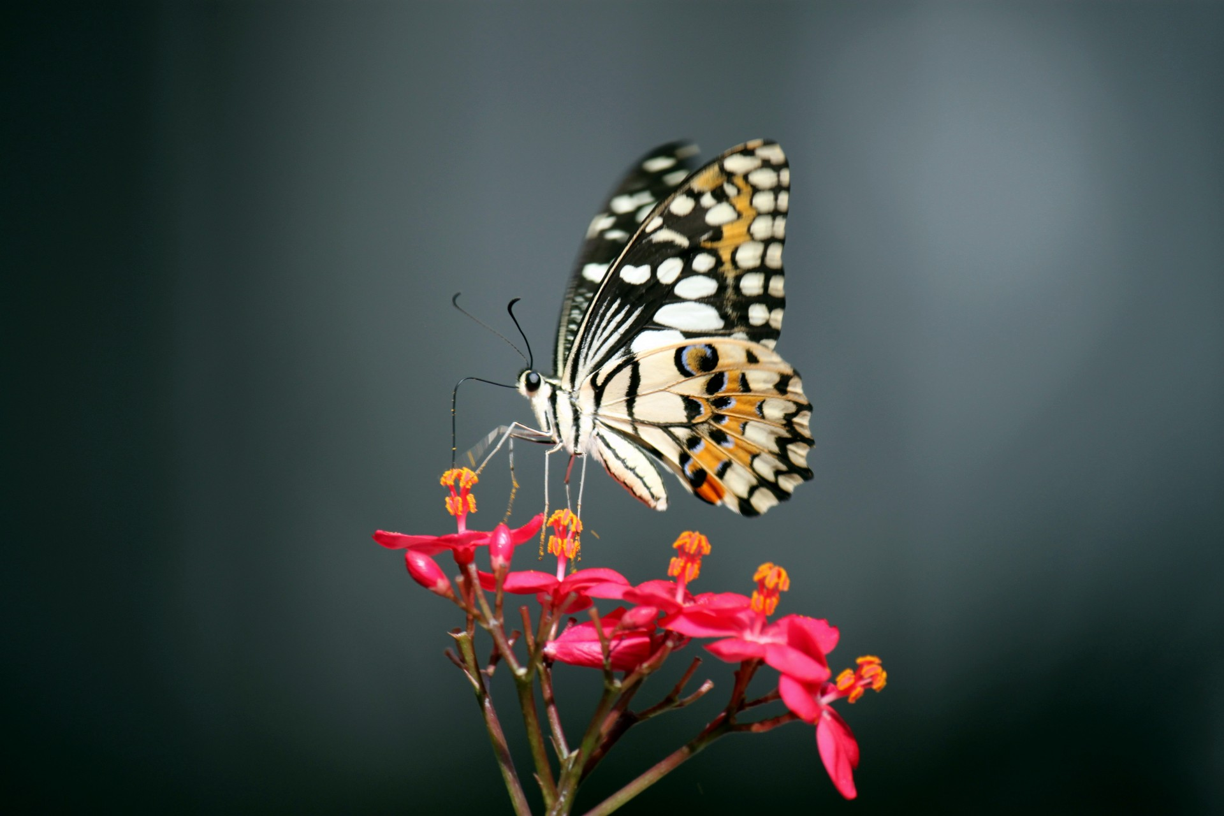
Details: Studies & Special Projects

Slide 14
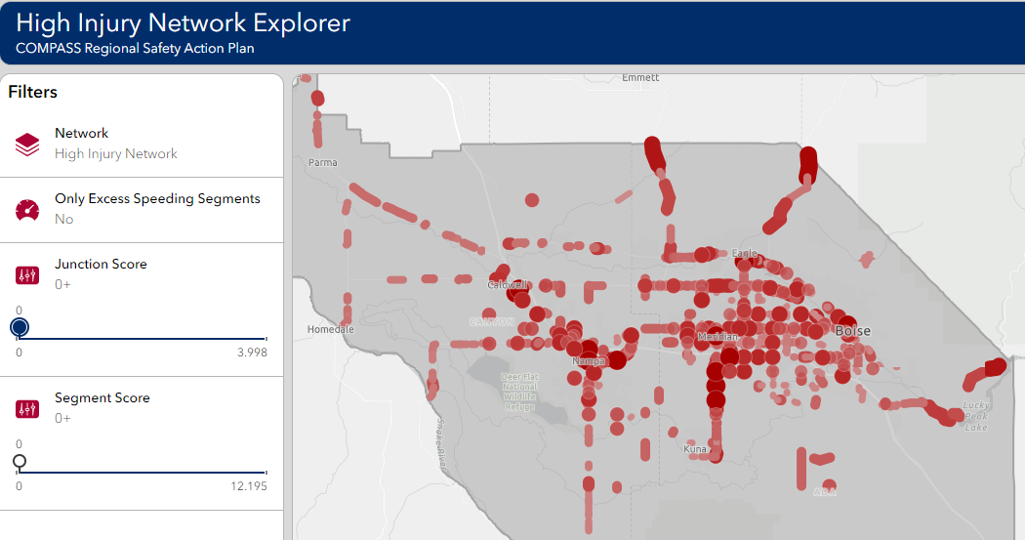
High Injury Network
Sponsor: COMPASS
Fund Eligibility: STBG-TMA/LU
Total Cost: $165,000
Request: $152,889
Local Rank: 1 of 4
Update the High Injury Network dashboard. The update will incorporate additional crash data and calculate the new High Injury Network.

Slide 15
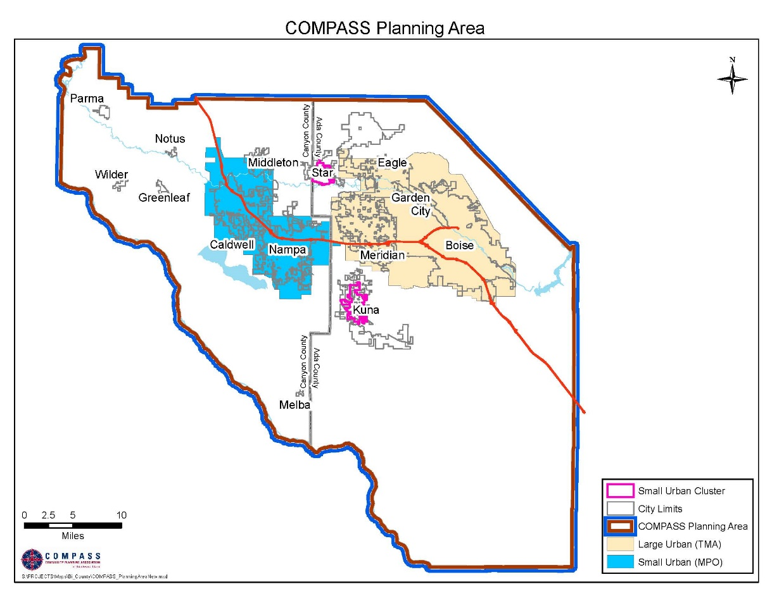
Fiscal Impact Analysis
Sponsor: COMPASS
Fund Eligibility: STBG-TMA/LU
Total Cost: $85,000
Request: $78,761
Local Rank: 2 of 4
To better implement the goals of Communities in Motion, this project will provide information on the fiscal impact of various growth patterns.

Slide 16
Pavement Condition Analysis
Sponsor: COMPASS
Fund Eligibility: STBG-TMA/LU
Total Cost: $180,000
Request: $166,788
Local Rank: 3 of 4
Analyze and report on existing pavement conditions on arterial roadways throughout COMPASS’ planning area.

Slide 17
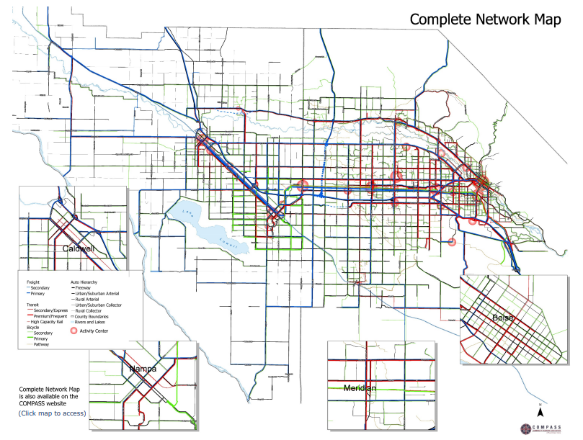
Complete Network Policy
Sponsor: COMPASS
Fund Eligibility: STBG-TMA/LU
Total Cost: $175,000
Request: $162,155
Local Rank: 4 of 4
Augment COMPASS
staff efforts with
consultant support to refresh the COMPASS
Complete Network Policy.

Slide 18
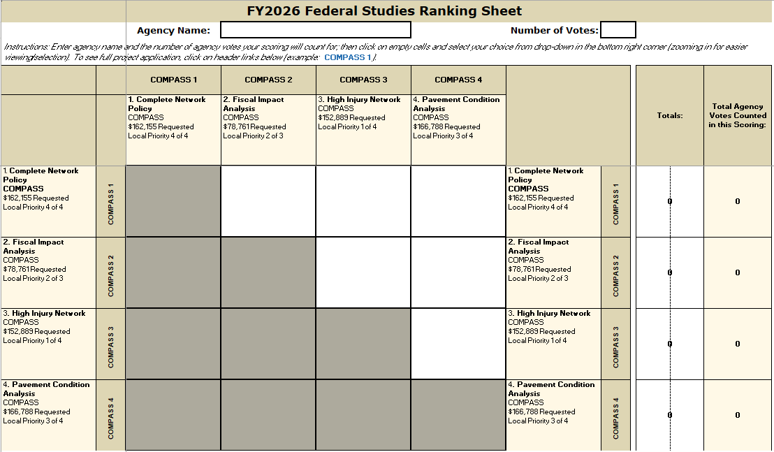
Paired Comparison Process

Slide 19
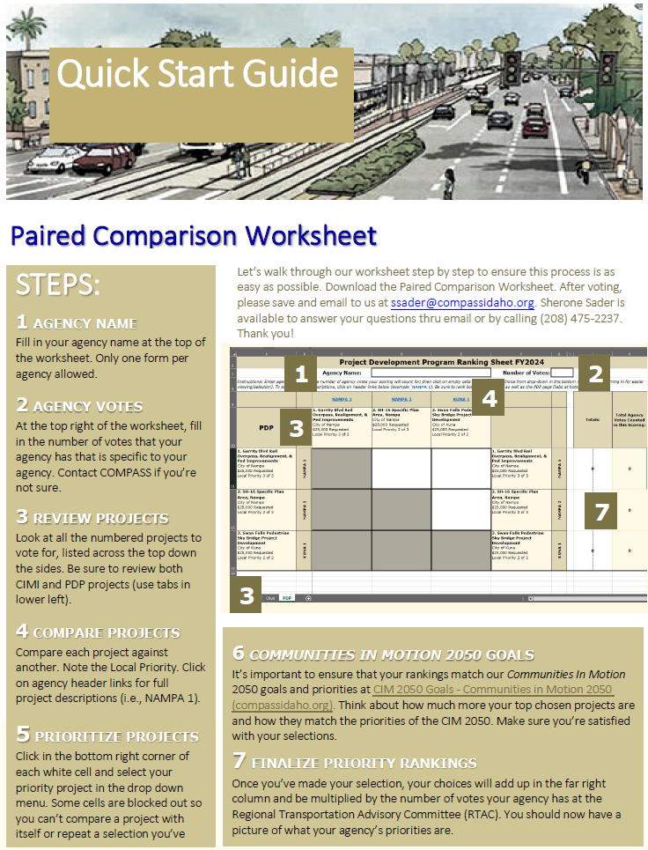
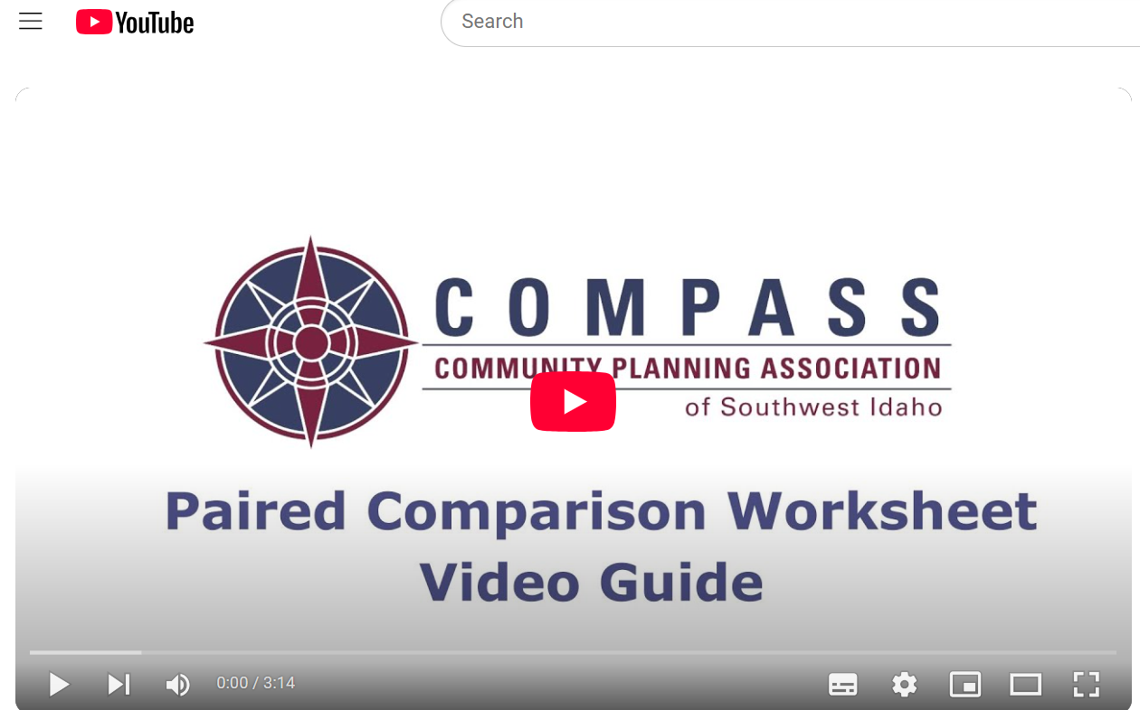
Paired Comparison Process

Slide 20
Details: Alternative Projects

Slide 21
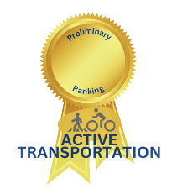
Ridenbaugh Canal Pathway
SCORE
136
Sponsor: City of Boise
Fund Eligibility: STBG-TMA, TAP-TMA, CRP-TMA
Total Cost: $1,778,969
Request: $1,648,393
Local Rank: 1 of 1
Install ½ mile of 12-foot multi-use pathway to connect between Maple Grove Road and Milwaukee Street along the Ridenbaugh Canal corridor (north of Emerald Street).

Slide 22
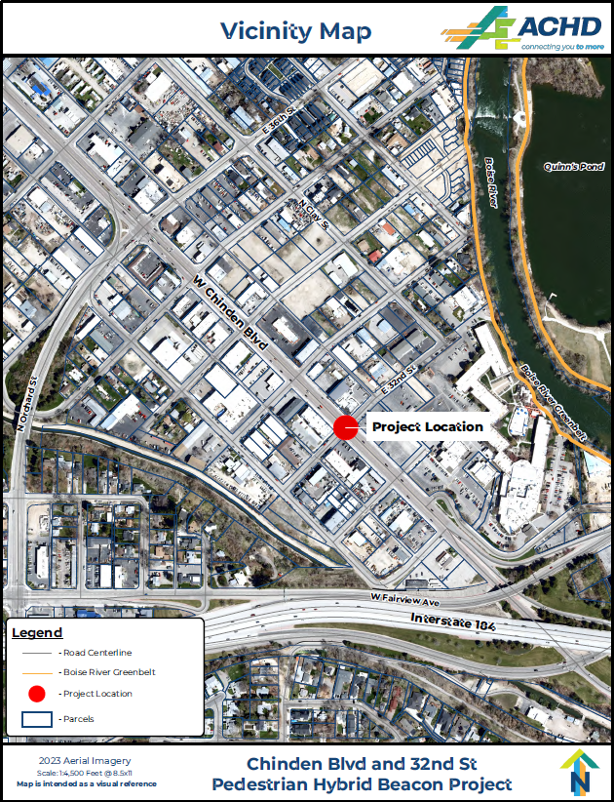
Pedestrian Crossing at 32nd Street, Garden City
SCORE
108
Sponsor: Ada County Highway District
Fund Eligibility: STBG-TMA, TAP-TMA, CRP-TMA
Total Cost: $450,000
Request: $417,000
Local Rank: 1 of 1
Design and build a pedestrian hybrid beacon-controlled crossing on Chinden Boulevard at 32nd Street, Garden City.

Slide 23
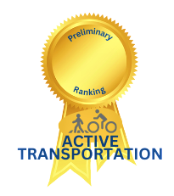
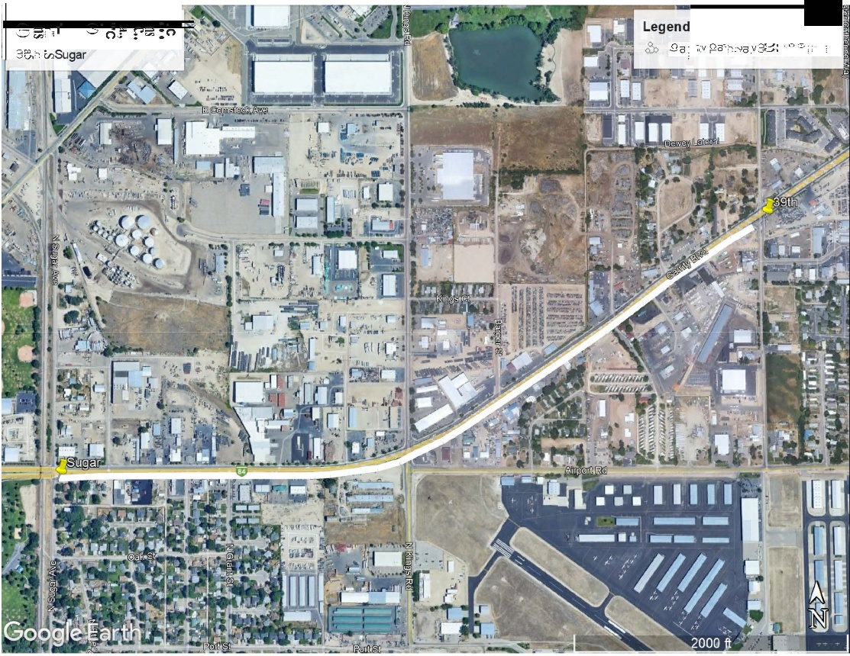
Interstate 84B 39th Street to Sugar Road, Sidepath
SCORE
93
Sponsor: City of Nampa
Fund Eligibility: STBG-LU, TAP-LU (LHTAC)
Total Cost: $2,125,116
Request: $1,969,132
Local Rank: 8 of 16
Construct a sidepath along I-84B (Garrity Boulevard) from 39th to Sugar Road for bi-directional and multi-use.

Slide 24
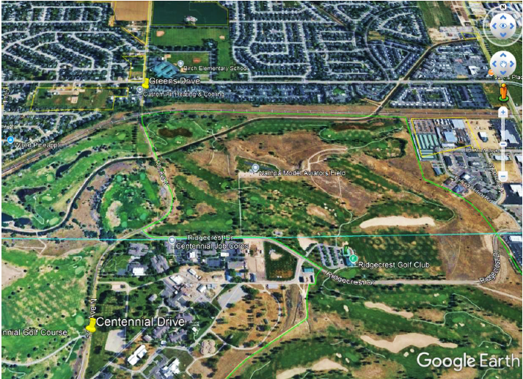
11th Avenue Sidepath
SCORE
87
Sponsor: City of Nampa
Fund Eligibility: STBG-LU Competitive
Total Cost: $6,469,000
Request: $5,994,175
Local Rank: 15 of 16
Improve existing 11th Avenue North with added pathway, beautification, irrigation repair, and numerous amenities.

Slide 25
Details: Roadway Projects

Slide 26
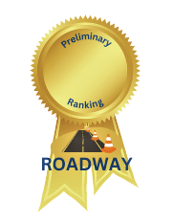
Northside Boulevard and Ustick Road Roundabout
SCORE
90.28
Sponsor: City of Nampa
Fund Eligibility: STBG-LU
Total Cost: $17,390,000
Request: $7,825,500
Local Rank: 16 of 16
Reconstruct the intersection of Ustick Road and Northside Boulevard converting it from a four-way stop to a roundabout with curb and gutter, landscape buffer, and sidewalk/path.

Slide 27
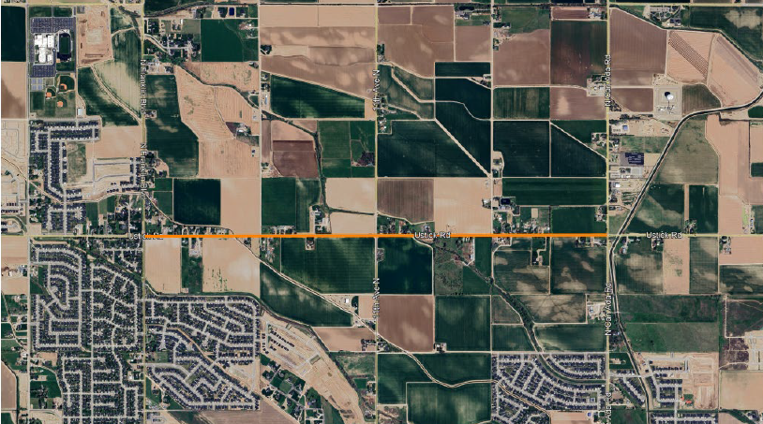
Ustick Road Widening, Franklin Boulevard to CanAda Road
SCORE
90.28
Sponsor: City of Nampa
Fund Eligibility: STBG-LU Competitive
Total Cost: $27,826,000
Request: $12,521,700
Local Rank: 5 of 16
Widen the corridor of Ustick Road from two lanes to five lanes with curb and gutter, landscape buffer, sidewalk/path, raised median, and replaced bridge.
1st Street

Slide 28
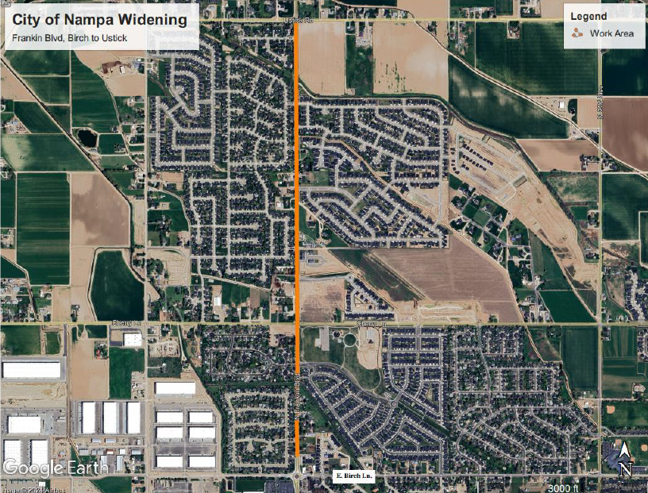
Franklin Boulevard Widening, Birch Lane to Ustick Road
SCORE
90
Sponsor: City of Nampa
Fund Eligibility: STBG-LU Competitive
Total Cost: $22,774,000
Request: $21,102,388
Local Rank: 10 of 16
Widen Franklin Boulevard from two to five lanes, from Birch Lane to Ustick Road, including a signalized intersection, PHB and RRFB crossings, and sidewalk.

Slide 29
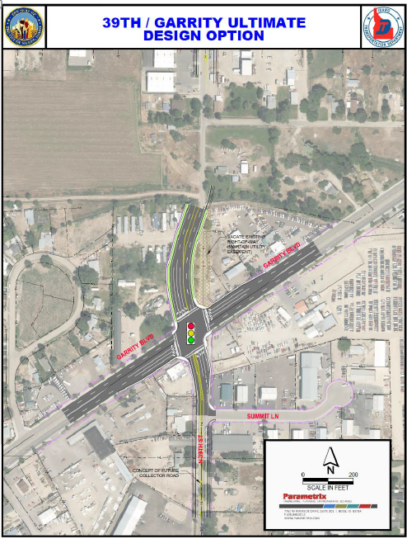
North 39th Street and Garrity Boulevard, Signal
SCORE
82
Sponsor: City of Nampa
Fund Eligibility: STBG-LU
Total Cost: $4,675,139
Request: $4,331,984
Local Rank: 11 of 16
Signalized improvements and intersection re-alignment at North 39th Street and Garrity Boulevard, Improvements include dedicated left turn lanes, bike lanes, sidewalks, streetlights, and lane widening.

Slide 30
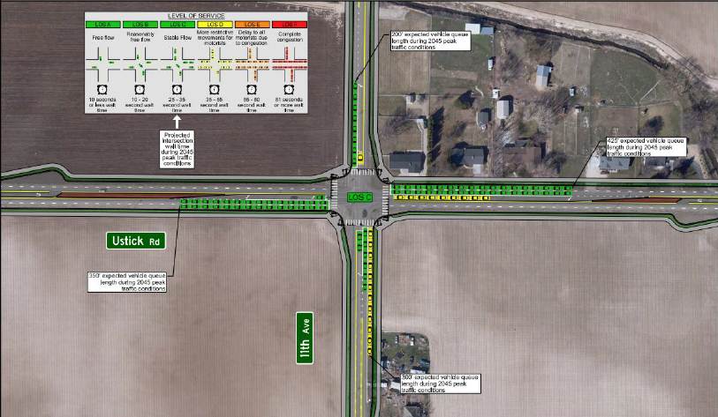
11th Avenue and Ustick Road, Signalized Intersection Improvements
SCORE
80.28
Sponsor: City of Nampa
Fund Eligibility: STBG-LU
Total Cost: $5,561,000
Request: $5,152,823
Local Rank: 9 of 16
Reconstruct the intersection of Ustick Road and 11th Avenue North to include additional travel lanes, curb and gutter, landscape buffer, sidewalk/path and a traffic signal.

Slide 31
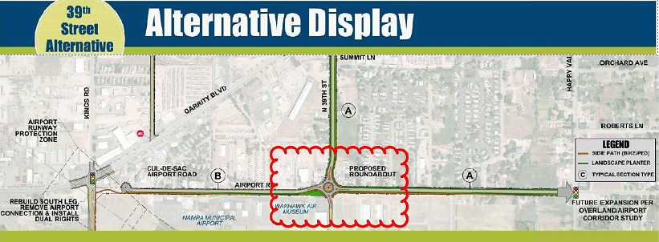
North 39th Street and Airport Road, Roundabout
SCORE
78
Sponsor: City of Nampa
Fund Eligibility: STBG-LU
Total Cost: $5,268,000
Request: $4,881,329
Local Rank: 14 of 16
Improve the intersection of North 39th Street and Airport Road by constructing a single-lane roundabout, with sidewalk and/or pathway adding curb and gutter.

Slide 32
Madison Road and Ustick Road Intersection Improvements
SCORE
77.28
Sponsor: City of Nampa
Fund Eligibility: STBG-LU
Total Cost: $7,712,000
Request: $7,145,939
Local Rank: 13 of 16
Reconstruct the intersection of Ustick Road and Madison Road converting it from a stop-controlled four-way junction to a roundabout intersection with curb and gutter, landscape buffer and sidewalk/path.

Slide 33
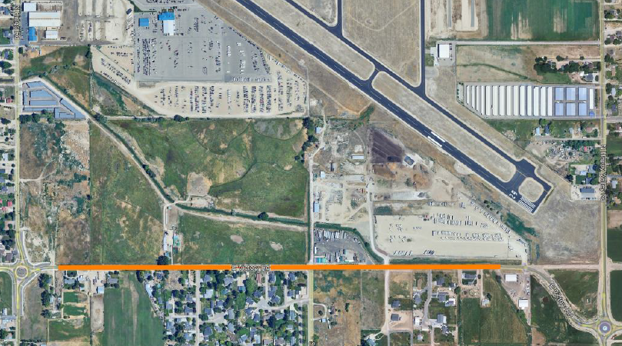
Victory Road, Kings Road to Happy Valley Road Pavement Conditions
SCORE
77
Sponsor: City of Nampa
Fund Eligibility: STBG-LU
Total Cost: $579,552
Request: $537,012
Local Rank: 4 of 16
Re-pave the length on Victory Road from Kings Road to Happy Valley Road.
Victory Rd

Slide 34
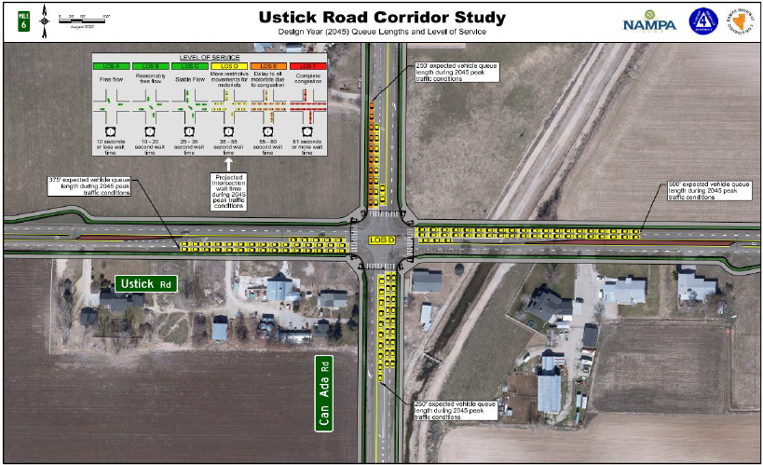
CanAda Road and Ustick Road Signalized Intersection
SCORE
75.28
Sponsor: City of Nampa
Fund Eligibility: STBG-LU Competitive
Total Cost: $19,945,000
Request: $18,481,037
Local Rank: 1 of 16
Reconstruct the intersection of CanAda Road and Ustick Road to include additional travel lanes, curb and gutter, landscape buffer, sidewalk/path and a high-capacity traffic signal.

Slide 35
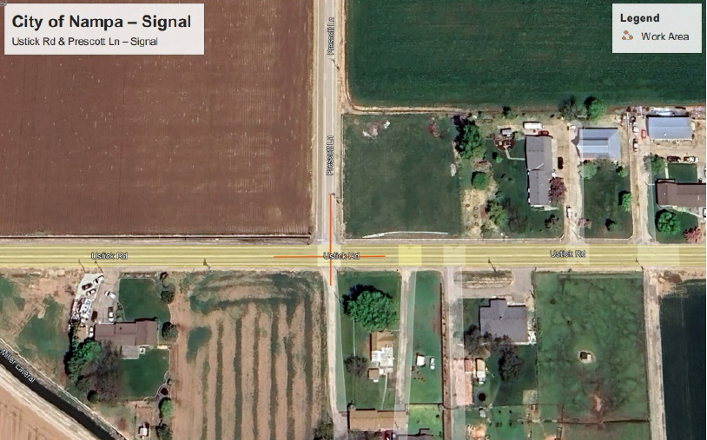
Prescott Lane and Ustick Road Signalized Intersection
SCORE
75.28
Sponsor: City of Nampa
Fund Eligibility: STBG-LU
Total Cost: $5,757,000
Request: $5,334,436
Local Rank: 12 of 16
Reconstruct the intersection of Ustick Road and Prescott Lane, converting it from a one-way stop at Prescott to a signalized traffic system with lighting and a wide pathway.

Slide 36
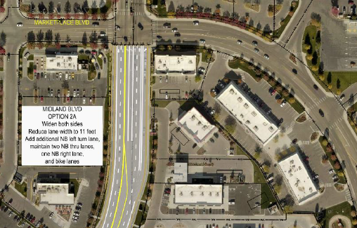
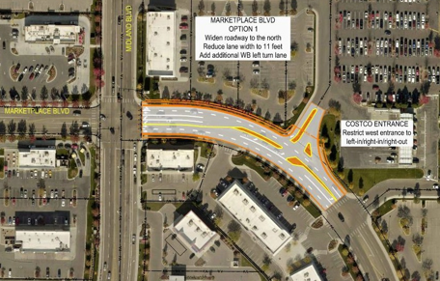
Midland Boulevard and Marketplace Safety Improvements
SCORE
74
Sponsor: City of Nampa
Fund Eligibility: STBG-LU
Total Cost: $4,650,527
Request: $4,309,178
Local Rank: 2 of 16
Update the intersection of Midland Boulevard and North Marketplace Boulevard to include safety improvements of installing a center median on Marketplace Boulevard (east of the actual intersecting roads) and widening of the roadway at the east and west legs of the intersection for additional capacity.

Slide 37
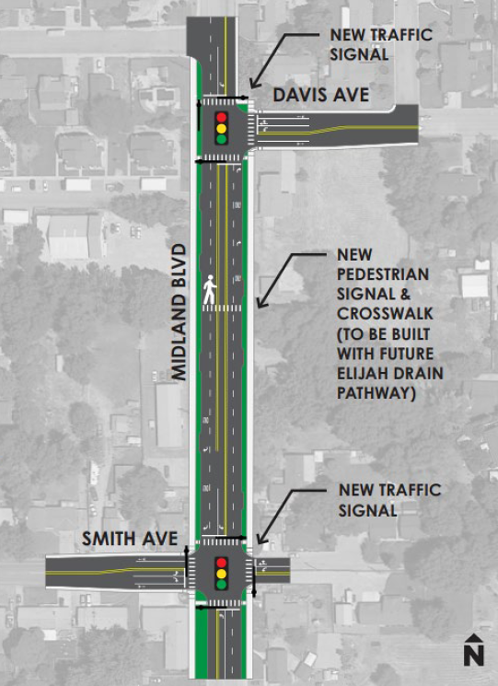
Midland Boulevard and Davis Avenue Signalized Intersection
SCORE
73
Sponsor: City of Nampa
Fund Eligibility: STBG-LU
Total Cost: $4,774,000
Request: $4,423,588
Local Rank: 7 of 16
Reconstruct the intersection of Midland Boulevard and Davis Avenue to include paved travel lanes in each direction, curb and gutter, landscape buffer, sidewalk/path, and a signal.

Slide 38
Ustick Road and North Franklin Boulevard Signalized Intersection
SCORE
70.28
Reconstruct the intersection of Ustick Road and North Franklin Boulevard to include additional travel lanes, curb and gutter, landscape buffer, sidewalk/path, and a signal.
Sponsor: City of Nampa
Fund Eligibility: STBG-LU Competitive
Total Cost: $5,621,481
Request: $5,208,864
Local Rank: 3 of 16

Slide 39
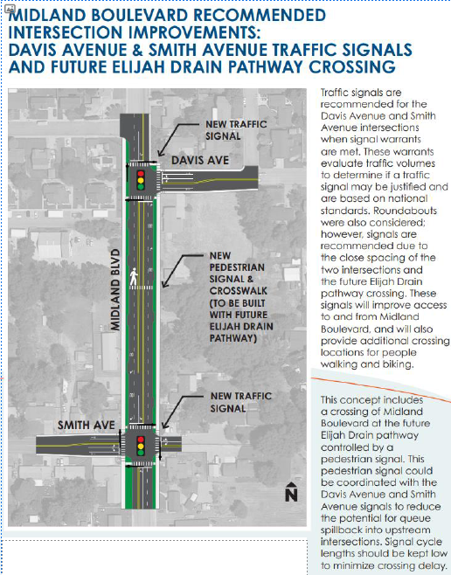
Midland Boulevard and Smith Avenue Signalized Intersection
SCORE
68
Sponsor: City of Nampa
Fund Eligibility: STBG-LU
Total Cost: $3,034,000
Request: $2,811,304
Local Rank: 6 of 16
Reconstruct the intersection of Midland Boulevard and Smith Avenue to include paved travel lanes in each direction, curb and gutter, landscape buffer, sidewalk/path, and a signal.

Slide 40
Conclusion/summary
Get a deeper understanding of each application, to help guide your review.
Provide time for discussion among all agencies.
Understanding of preliminary scoring process
Reminder: Paired Comparisons are due February 12th!
Notes:
Slide does not have to say “conclusion” or “summary” (I like “Remember!”), but do tell them what you told them.

Slide 41
Questions?

Slide 42
Contact
Toni Tisdale
Principal Planner, Resource Development Team Lead
ttisdale@compassidaho.org
Matt Carlson
Grant Writer and Administrator
mcarlson@compassidaho.org
Sherone Sader
Resource Development Assistant
ssader@compassidaho.org
Find us online!
www.compassidaho.org
www.facebook.com/compassidaho
www.instagram.com/compassidaho
www.twitter.com/compassidaho
www.youtube.com/compassidaho
www.linkedin.com/company/compassidaho
www.nextdoor.com/COMPASSidaho

